Slide 1

Sanjivani College of Engineering, Kopargaon. Department of Computer Engineering. 2019-2020
“Social Network With Advanced Messaging System”
GROUP-ID: 03
Guided by: prof. P.SaiPrasad
Presented by:
Sr. No | Name of the Student | PRN
1. | Sabale Akash Shankar | 71704331C
2. | Sagam Sanket Rajendra | 71704336D
3. | Magar Shubham Popatrao | 71704217M
4. | Mahajan Nilesh Navnath | 71604395F

Slide 2
PROBLEM DEFINITION
In today’s world, there are lot of social networks available but each one has some limitations like in What's App, same messages are coming from different people multiple times such as a missing person’s photo or any incident happens news keep on forwarding even if the incident passed long time or even missing of person found.
In our system, we assign a unique id to message to detect from where is that message coming. system stop this message from forwarding more after reporting by anyone.

Slide 3
PROBLEM DEFINITION
In above situation system block some of the messages that should not be received further more from specific or all users. Some predefined rules also present ex. terrorism, drugs, kidnapping which check by default and user have option to set own rules for incoming messages. This system classify post in different categories based on its content.

Slide 4
LITERATURE SURVEY
SR.NO | TITLE | AUTHOR |  | REMARK
1] | A System to Filter Unwanted Messages from OSN User Walls Using Inference Attacks on Social Networks | S. R. Pandit, Pooja Bhoyar, Kiran Sarode, Supriya Kadam, Sayali More |  | They provides an active support in complex and sophisticated tasks involved in OSN management, such as for instance access control or information filtering. Classification is done to avoid overwhelmed data for user.
2] | Filtering Unwanted Messages from Online Social Networks(OSN) using Rule Based Technique | Sujapriya. S,G. Immanual Gnana Durai., Dr. C.Kumar Charlie Paul. |  | he system develops a machine learning classifier to implement customize content dependent filter rules.
3] | Military Textual Analysis and Chat Research | Emily W. Medina |  | is somewhat unique in that a room can exist beyond the time users are logged in; users can join and exit a room at any time, and the conversation can continue with other participants.

Slide 5
LITERATURE SURVEY
SR.NO | TITLE | AUTHOR |  | REMARK
4] | MOBILE SOCIAL NETWORKS | A. Vijaya Lakshmi ,Dr. S. Britto Ramesh Kumar , P. Joseph Charles |  | This paper explains about the a social networking service which is a platform to build social networks or social relations among people who, for example, share interests, activities, backgrounds, or real-life connection
5] | Filtering Unwanted Post from Online Social Networking (OSN) Sites | Sachin P. Vidhate, Syed Akhter |  | One of the most important features of online social networks is to find and make friends with other site members. These messages can be filtered if they are unwanted by using machine learning classifier algorithm.
6] | Design and Implementation of Web Based Real Time Chat Interfacing Server | Diotra Henriyan, Devie Prathama Subiyanti, Rizki Fauzian, Dian Anggraini, M. Vicky Ghani Aziz |  | This chat application is an application that is used to communicate and developed to support especially the city of Bandung and the Indonesian people in general.

Slide 6
SCOPE OF PROJECT
Our system will be used in keyword base message filtering.
This system used to prevent un-appropriate message forwarding.
System gives ability to user to define there own rules for blocking.

Slide 7
OBJECTIVES OF PROJECT
To do message filtering.
To block specific message for single or multiple persons using user define rules.
To categorize posts based on content.

Slide 8
REQUIREMENTS- Normal Requirements:
Provide security for online post sharing and message sending.
Use https protocol.
System should be user friendly.
Different layouts for mobile, laptop, desktop, tab.
Create dummy social network where register at least 25 members.
Train members how to Sign up and login in system
System must be user friendly.
Use friendly icons with text for navigation’s, links, buttons
Photo, video download option should be available.
Provide virtual customized secured links for download.
Contd…

Slide 9
REQUIREMENTS- Normal Requirements:
Effectively post should get classified.
Use multi class label algorithms.
Properly messages should get spam as per rules define by user and system.
Count occurrences of words define in rules and if it cross limit then only spam it .
User should have privacy to make friend, remove friend, share post, delete post, send message without any limits and rules.
Higher scalable system to handle higher parallel request of members.
Accuracy of post classification should be good.
Use multi class classification algorithms

Slide 10
EXPECTED REQUIREMENTS- :
Database backup time to time.
Backup on daily, weakly or monthly to some external secure place
System handle big size of media files efficiently without crash.
Save files in minimized and compressed size in files.
Secure storage of database and client information.
: Use encryption to store users information and media file with salts, keys.
System rules should get auto generated as the most common rules define users.
Use machine learning.
System add some new class automatically.
Capability to learn itself using prediction algorithm .

Slide 11
EXCITED REQUIREMENTS- :
Authentication for user account.
Use 2 step authentication
Platform in dependant system.
: Select common platform for code which accept most of platforms.
Classification of post in minimum time.
Use multi threading or parallel computing at server side
Filter posts and messages in polynomial time.
: Use high processors or parallel computing.
Size of user expanding to 1000 and more members.
Use programming languages which has support high execution in less time (Python) and database which handle huge amount of data (MongoDB).

Slide 12
SYSTEM REQUIREMENTS
Hardware Requirements:-
RAM: 4GB
Hard disk: 500 GB+
LAN Cables
i3/i4/i7 processor
Software Requirements:-
Operating System: 64-bit Operating System.
Language: Python3, MYSQL, HTML, JS, CSS 3. Frameworks: python-django.
Drivers: python-mysql-connector, python-pymongo
Tools: Microsoft Visual code.
Database support: MySQL, MongoDB.

Slide 13
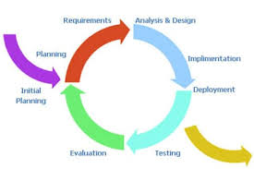
SELECTED PROCESS MODEL: Incremental Model

Slide 14
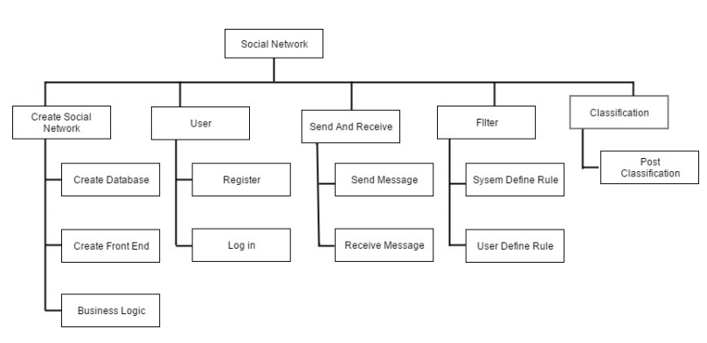
SYSTEM BREAKDOWN STRUCTURE

Slide 15
ALGORITHM
classification
Decision Tree
IF-THEN Rules
KNN

Slide 16
MATHEMATICAL MODELING
S = {I,P ,R,O}..........(1)
Where,
S=System
I=Input
P=Process
R=Rules
O=Output

Slide 17
Input {I}
is set of all inputs giving to system.
I = {I1, I2, I3, I4}..........(2)
Where,
I1 = Text Messages.
I2 = User Post.
I3= Message can be documents.
I4= Message can be audio/video

Slide 18
. Process {P} is set of processes followed.
P = {P 1,P 2,P 3,P 4,P 5}..........(3)
P1 = Accept user message/post.
P2 = Filter user shared post and messages send by user to each other by using System defined rules and user’s own rules
. P3 = Block the post/message if any matching pattern found with user owned defined rules or System rules.
P4 = If no any blocking or filtering rule match with user rule or system rule then send share post or send message.
P5 = After user share post and not match with blocking rule then by using post content classify as assign relevant label to this post such as motivational, comedy, political, adult, historic, news etc

Slide 19
{R} is set of rules to be followed.
R = {R1,R2,R3}..........(4)
Where, R1 = Terrorism, Casteism etc. messages are not allowed.
R2 = System filters only text messages.
R3 = Should support appropriate browser.

Slide 20
Output {O} is set of output expected from system.
O = {O1,O2}..........(4)
Where,
O1 = End user receives filtered Messages.
O2 = End user receives labeled post based on multi class classification algorithm.

Slide 21
DATABASE
users
Passwords
pics
Friend
Ppics
post
like dislike
message
comment
rules

Slide 22
RISK IDENTIFICATION
Hardware Risk
R1: System may crashed due to hardware failure.
R2: System may not work due to high processing data.
Business Impact
R3: Delay in project delivery (violation in time constraints) can hamper the customer economically.
R4: If System is not efficient than the existing system, will it cause economic losses?
R5: If fake message such as (Stock-Market) transferred forward may cause adverse effect on Business.

Slide 23
Customer Related Risk
R6: Client is a non technical person, if proper guidelines were not mention then it will create ambiguity.
R7: If user want any modifications that leads to modify the system which will go quit difficult.
Process Risk
R8: Selection of Software Process Model if not followed according to the defined degree can lead to confusion midway. Technical Risk
R9: Lack of training on tools and inexperience.
Development Environment related Risks
R10: Lack of proper training and less knowledge of programming leads a moderate risk. It will delay product development and deployment.

Slide 24
Database Risk
R11: Database injection attacks
R12: Data corruption
R13: Data loss caused by the entry of invalid data or commands
R14: Mistakes in database or system administration processes

Slide 25
STRATEGIS USD TO REDUCE RISKS
S1: Formulation and follow up of the project plan on regular basis.
S2: Keep assigned work under certain deadlines.
S3: Regular meeting with clients reduce the risk to some extent.
S4: Design system with flexibility and maintain necessary documentation for the same.
S5: Re-defined software process at higher degree.
S6: In module if image or document exceeds the specified size limit then it should generate error message informing the users about the same.

Slide 26
S7: Brief guidelines as well as proper instructions for using this system should be given to the end user for better understanding.
S8: Proper training on required technical tools for development of project reduce risk.
S9: Make certain that each one the members are taking part inside the design.
S10: Study and understanding of project definition, programming language.
S11: Detailed study of required system and proper selection of Software process model.

Slide 27
S12: Make sure that we learn the development tool within time, so that we do not have much problem during implementation.
S13: Each and every module must be tested for its functioning.
S14: After unit testing, system must be integrated and validated accordingly.
S15: Assessing for any database vulnerabilities, identifying compromised endpoints and classifying sensitive data.
S16: Managing user access rights and removing excessive privileges and dormant users.

Slide 28
S17: Monitoring all database access activity and usage patterns in real time to detect data leakage, unauthorized SQL and big data transactions, and protocol and system attacks.
S18: Blocking malicious web requests.
S19: Archiving external data and encrypting databases.
S20: Training employees on risk-mitigation techniques including how to recognize common cyber threats such as a spear-phishing attack, best practices around Internet and e-mail usage, and password management.
S21: Automating auditing with a database auditing and protection platform.

Slide 29
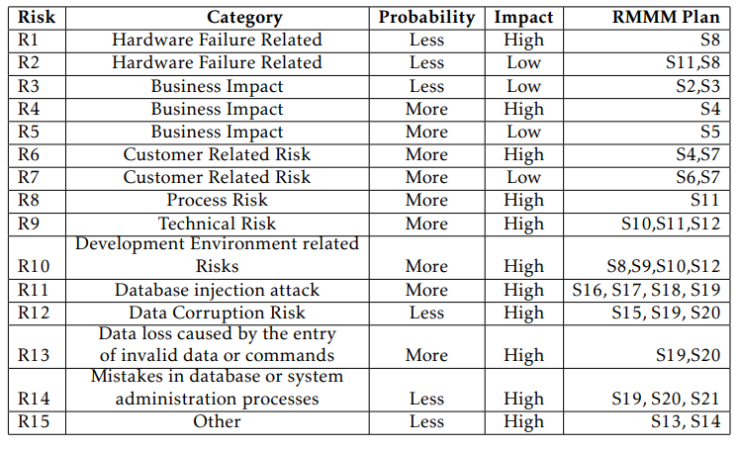
RISK PROJECTION

Slide 30
APPLICATIONS
System useful to prevent unwanted message to circulate.
The system can be used to filter spam content.
User knows that what about this post before reading so he can decide importance

Slide 31
We can use it to know friends and keep contact with friends that belongs to different countries. Social media changed our life so much.
Our life became more convenient because social media is a very useful tool for us in 21st century, it could help us to improve our life. However, we have to aware of how we use them. If we could use the social media smartly, having social media will become a good change for us.

Slide 32
FUTURE SCOPE
Can filter content of media file such as text file, pdf file, docx.
System can be used to process the Audio, video Messages etc.

Slide 33
CONCLUSION
This system will develop a web-based social network for society which offers spamming, blocking options for messages.
This system provides classified posts and rules based message passing to direct to inbox or spam.
Social media is a really convenient and important communicate network for all the people nowadays.

Slide 34

Thank You Any Questions ?

